Slide 1
Financially support a graduate student to attend conferences, through a refund.
CTG does not cover expenses:
Debates
Retreats
Workshops
Summer schools
Any tuition-based events
Conferences occurring at UCR
Allowable types of expenses:
Airfare
Mileage
Checked baggage fees
Shuttles, taxis, parking
Lodging
Registration
GSA will reimburse expenses for the duration of the conference
Plus 1 day before and 1 day after the conference. (west and continental)
Plus 2 days before and 2 days after the conference (international trips)
The reimbursement is individual and personal, it cannot be split among several people and costs made by third parties are not accepted.

Slide 2
Regional Caps

Slide 3
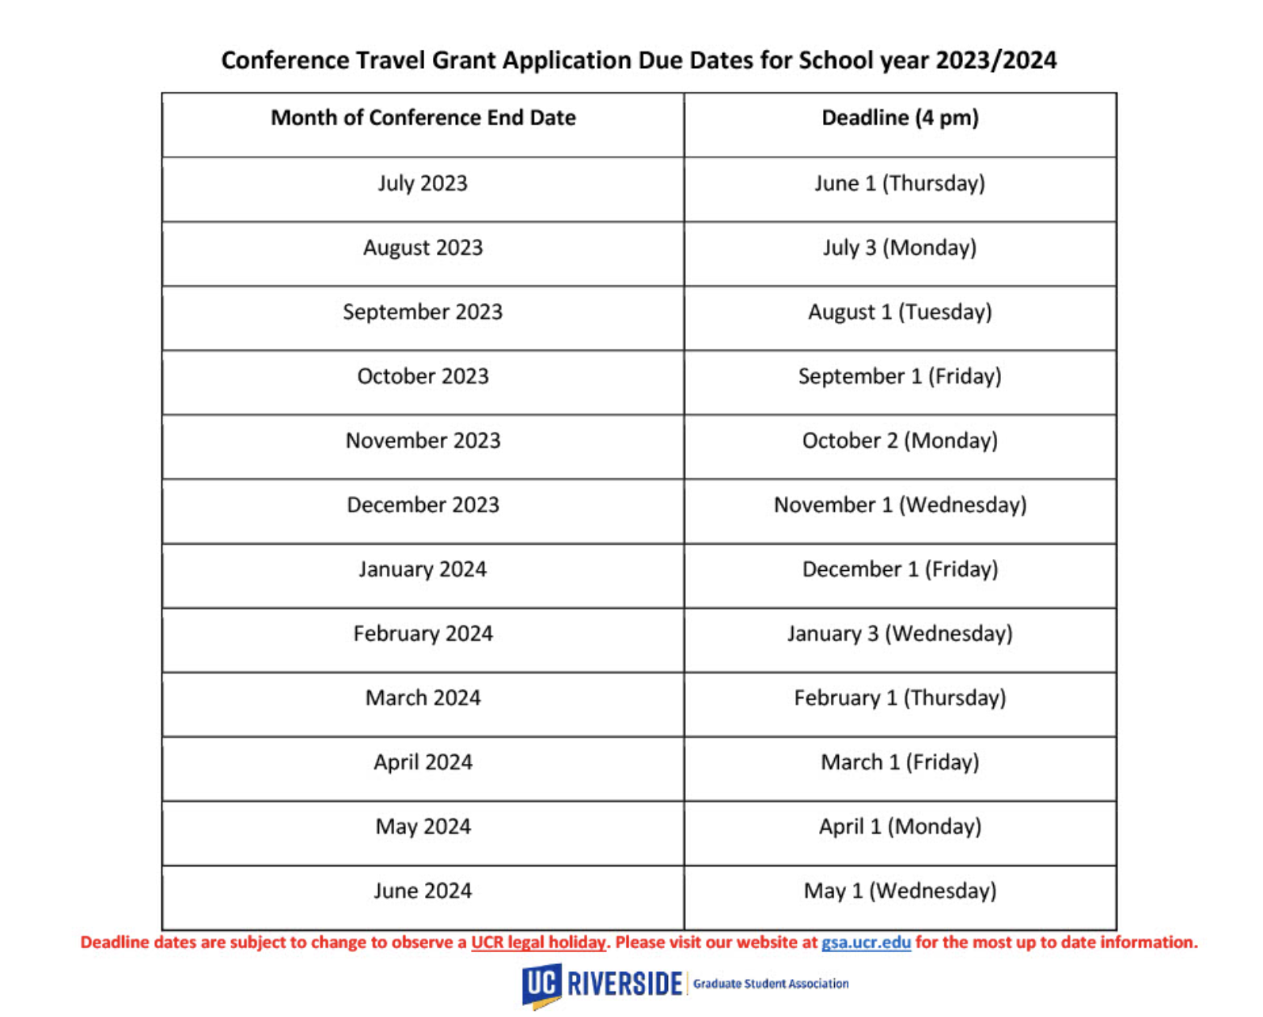
Deadlines

Slide 4
Step one
(before conference)

Slide 5
https://gsa.ucr.edu/ctg/

Slide 6
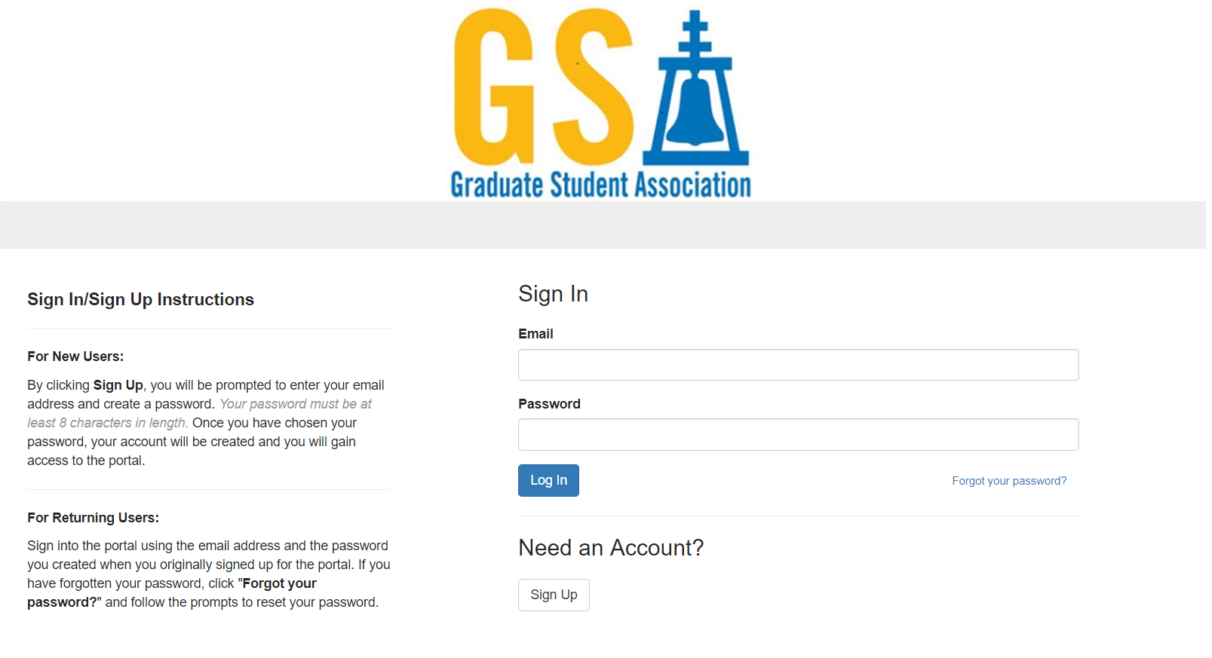
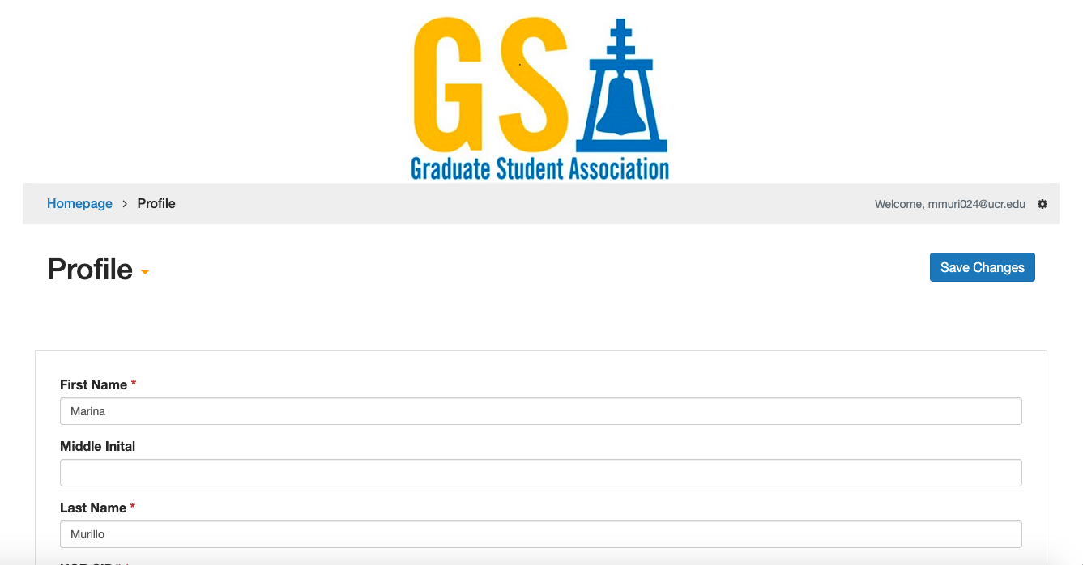
Old user
First time

Slide 7
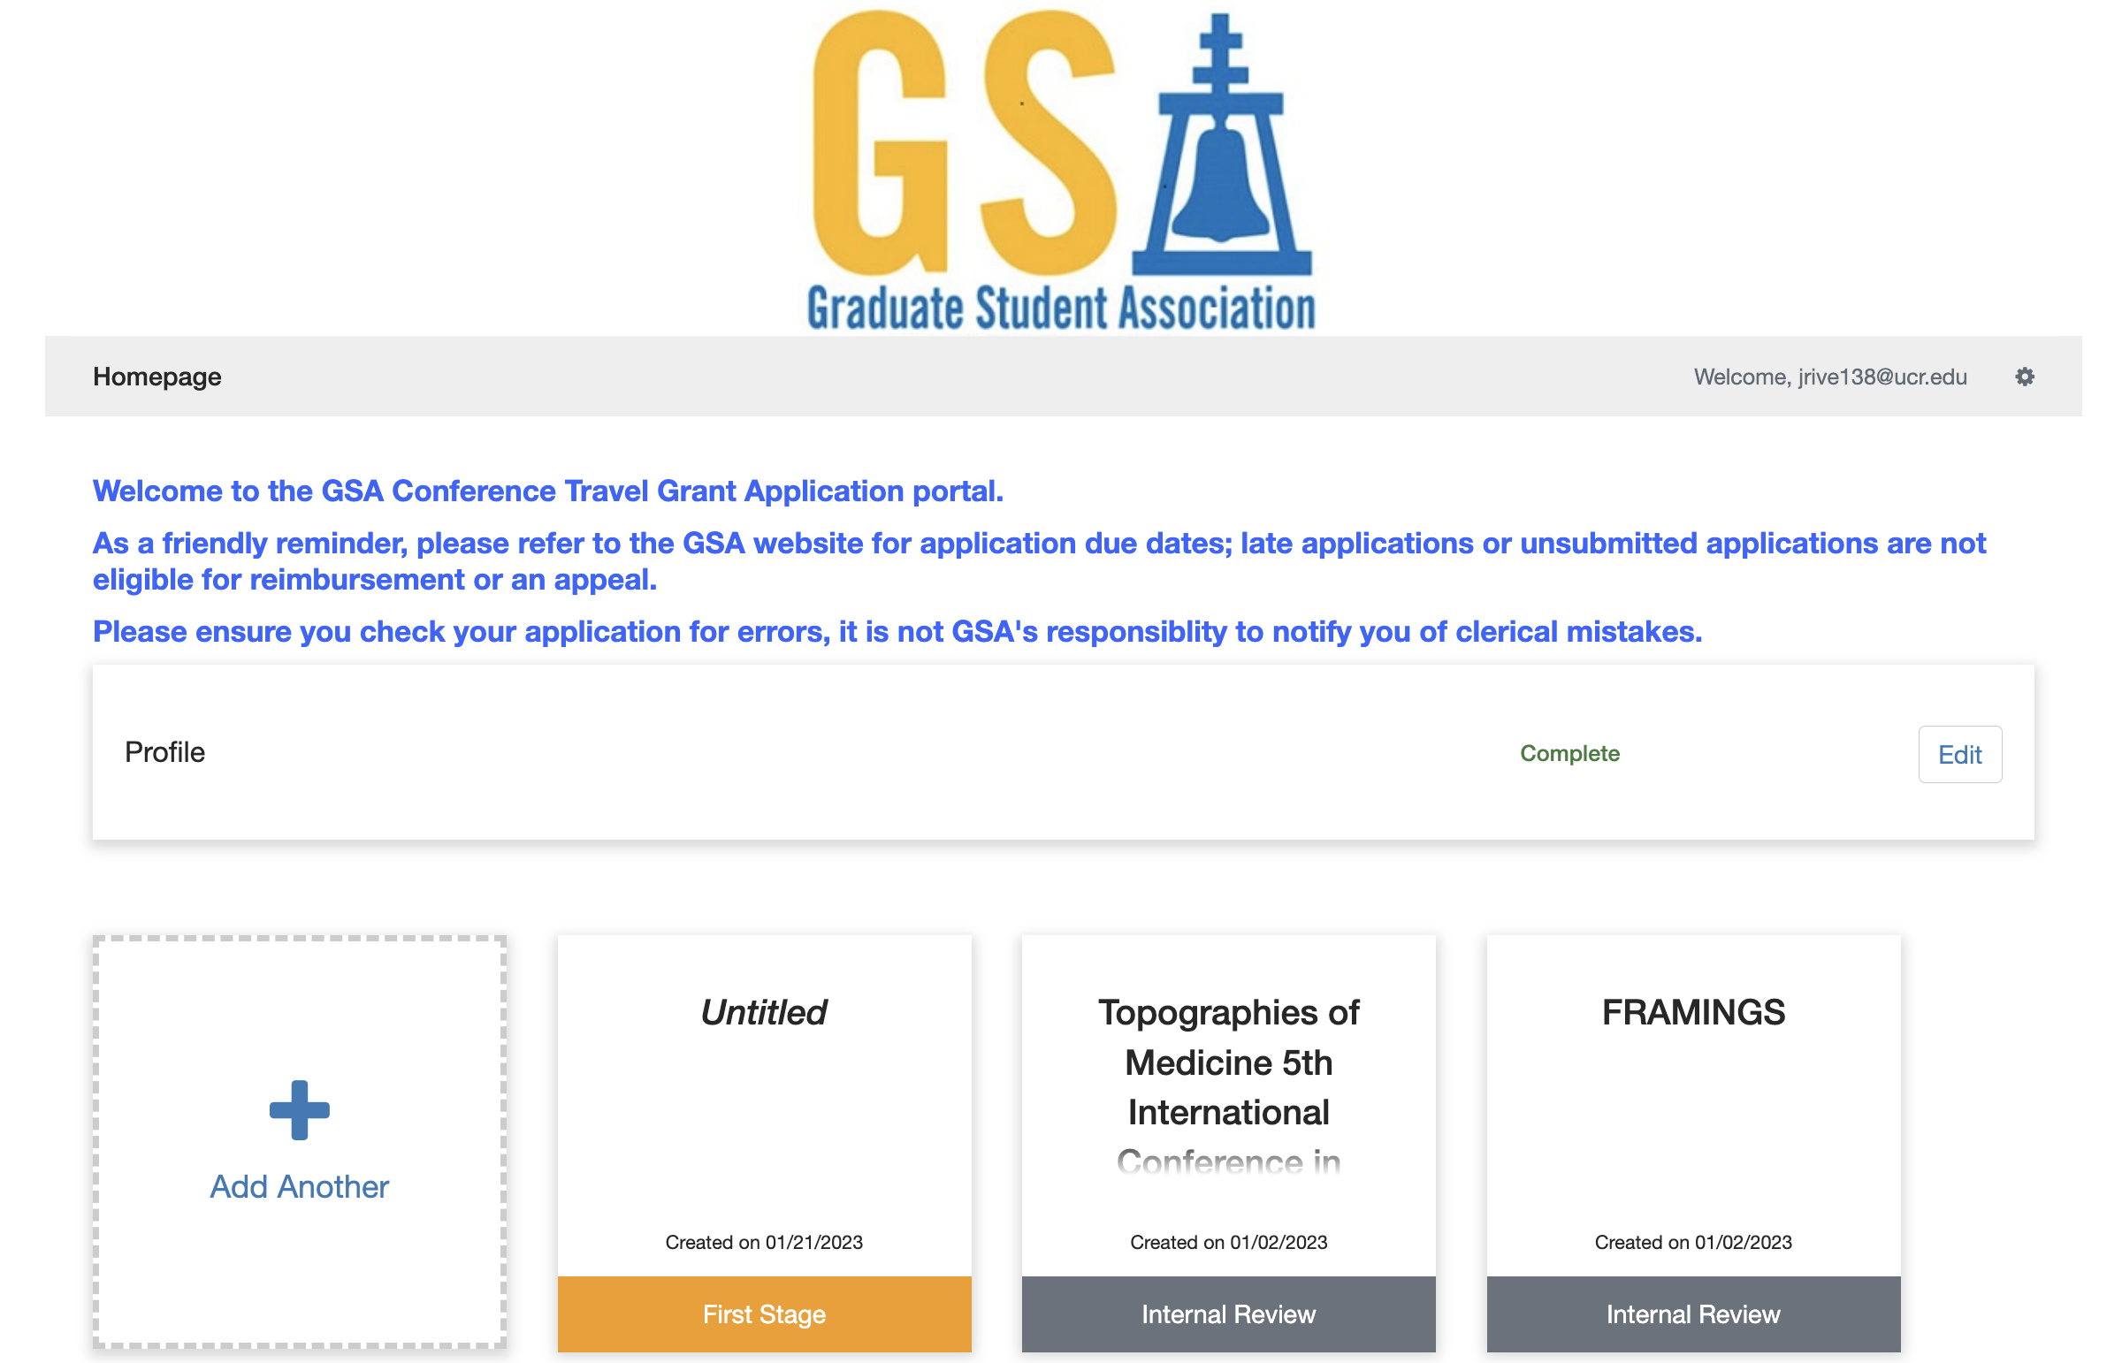

Slide 8
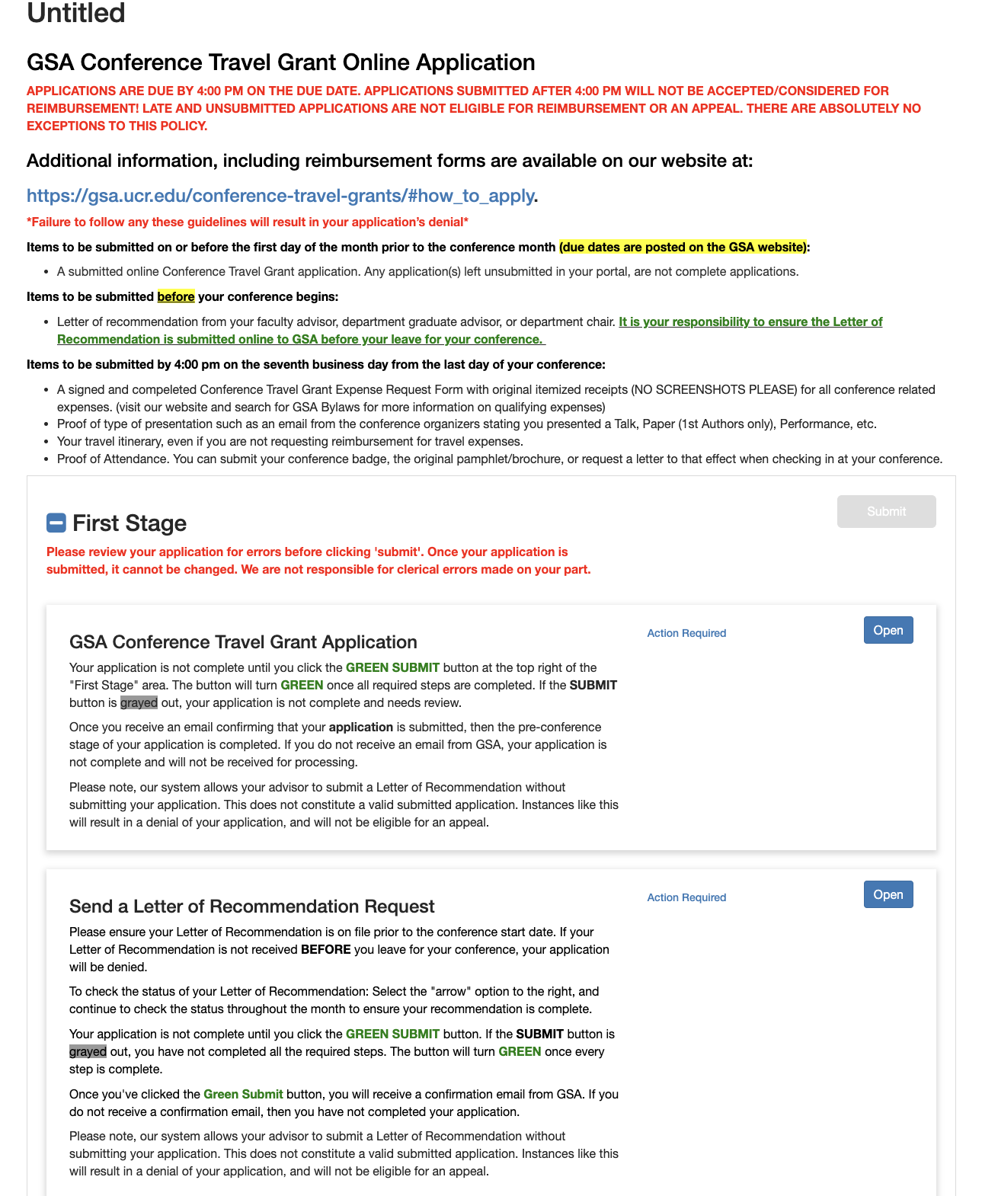
1

Slide 9
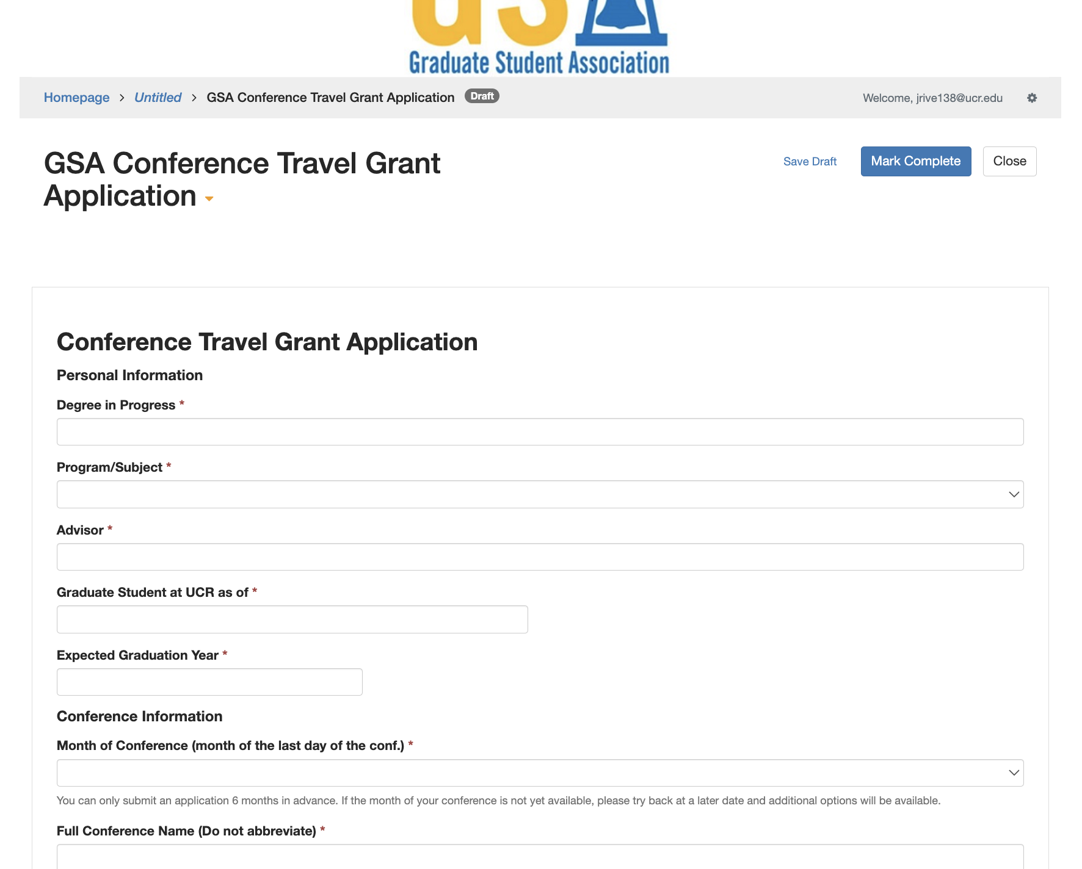
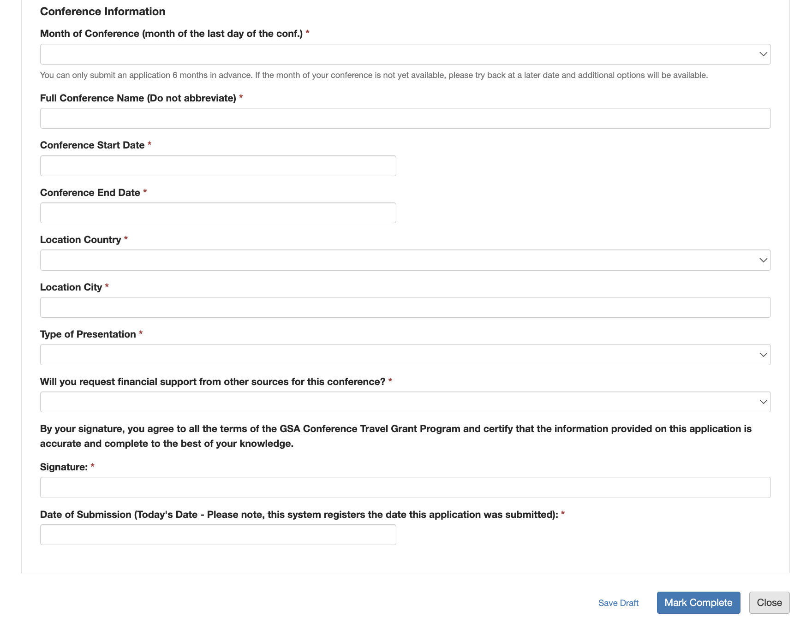
1

Slide 10
1
2

Slide 11
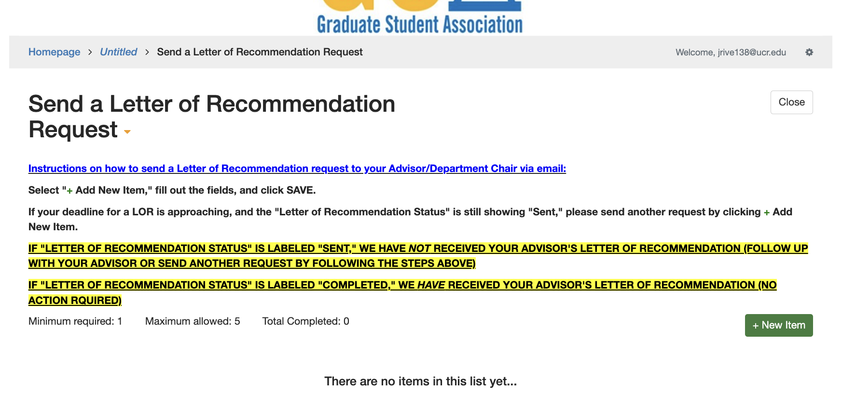
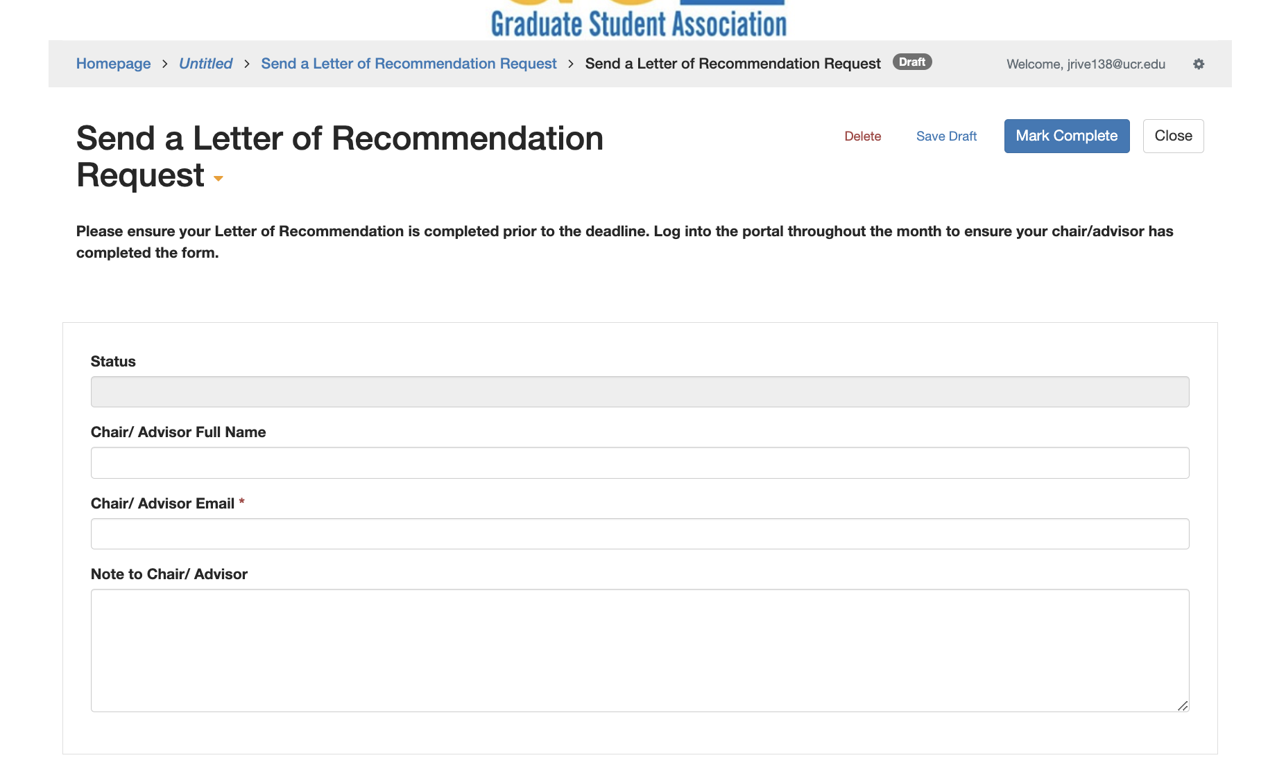
2

Slide 12
Draft mode
3
Submited
1
2

Slide 13
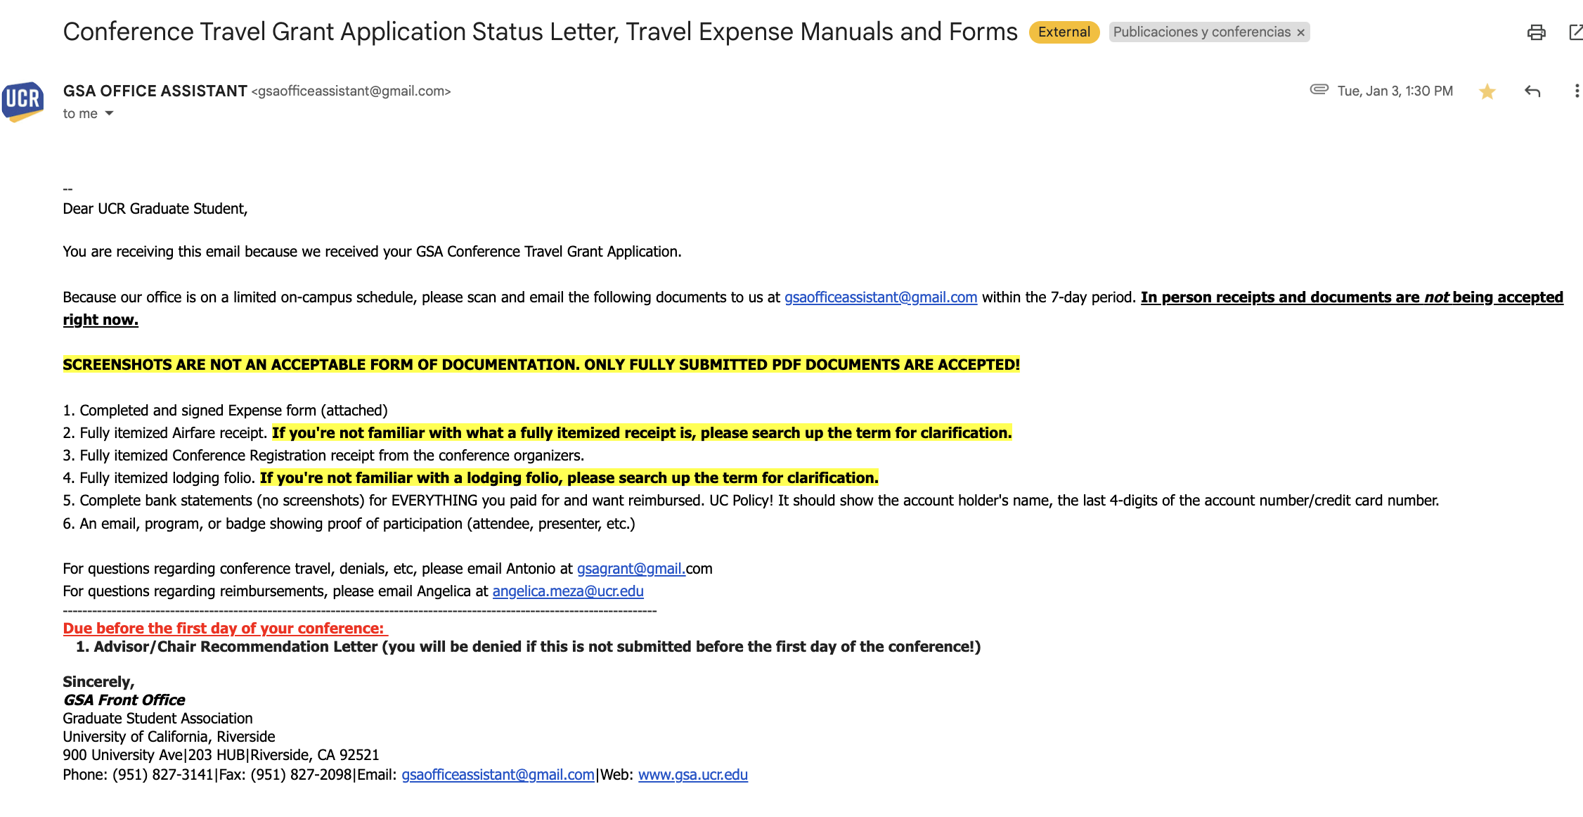
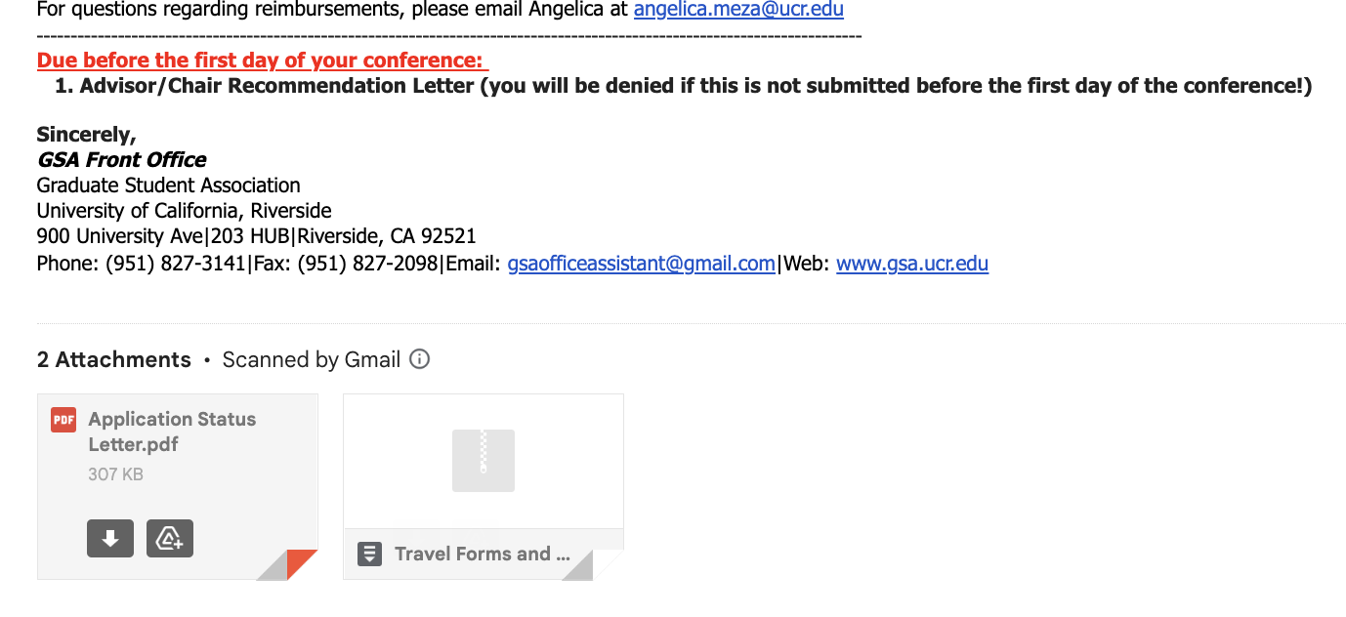
Submited email confirmation
CTG Expense Form

Slide 14
Step two
(post conference)

Slide 15
Items to be submitted after the conference:
All documents must be sent to: gsaofficeassistant@gmail.com by the end of the 7 business days NO EXCEPTIONS.
1.- Conference Travel Grant Expense Request Form.
2.- All original receipts and boarding passes.
3.- Proof of attendance (for attendees)
4.- Proof of Presentation (for presenters)
5.- Credit Card/Bank Account Statement or copy of your Account Activity.

Slide 16
Antonio Rivera-Montoya
Conference Travel Grant Coordinator
gsagrant@ucr.edu

